Slide 1
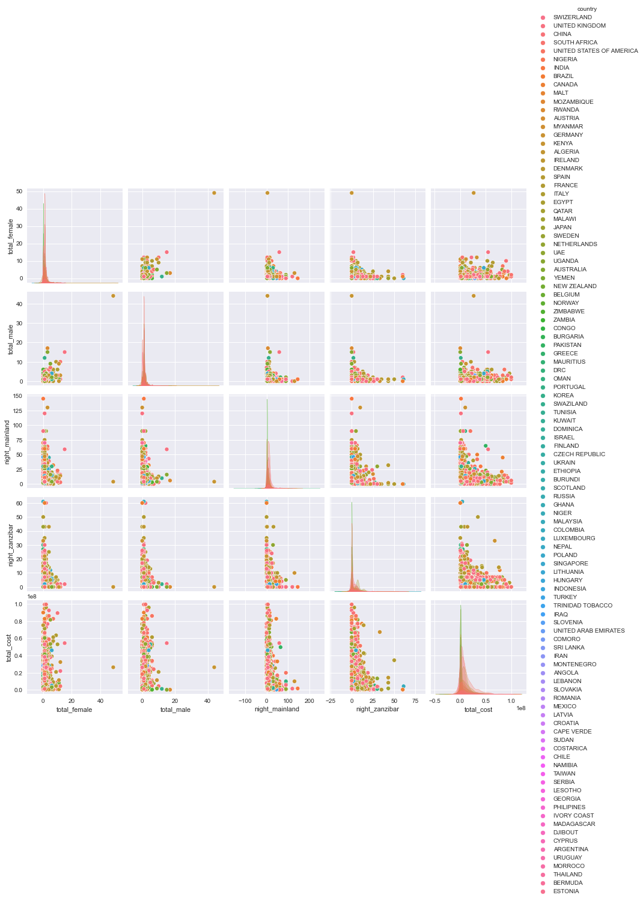
PAIRPLOT OF ALL FEATURES, WITH THE COUNTRIES AS HUES.
FIGURE 1

Slide 2
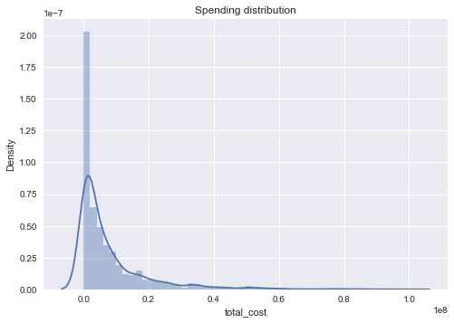
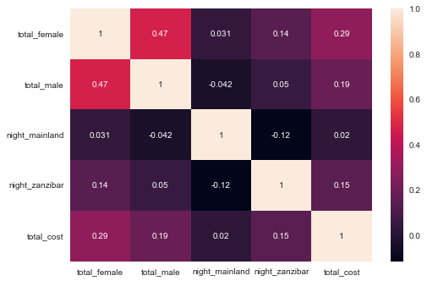
THE SPENDING DISTRIBUTION AND CORRELATIONS.
FIGURE 2

Slide 3
OBSERVATION OF FIGURE 2
THE AGE OF 25-44 SPENT MORE MONEY DURING THE TOUR IN TANZANIA
THERE IS A RELATIVELY HIGH CORRELATION BETWEEN FEATURES.

Slide 4
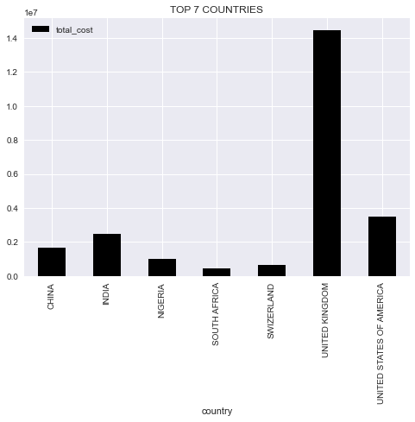
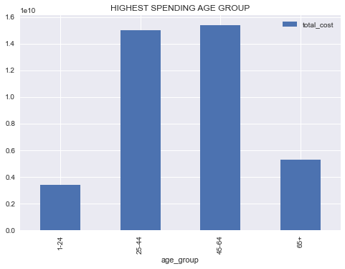
COUNTRIES WITH TOP 7 TOTAL COSTS STATISTICS AND HIGHEST SPENDING AGE GROUP
FIGURE 3

Slide 5
OBSERVATION OF FIGURE 3
TOURISTS FROM THE UNITED KINGDOM
HAD THE HIGHEST COSTS.
THE AGE OF 25-44 SPENT MORE MONEY
DURING THE TOUR IN TANZANIA

Slide 6
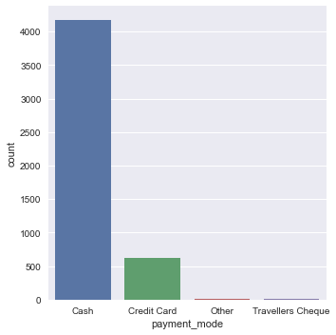
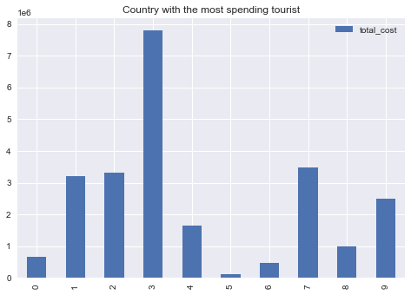
COUNTRIES WITH THE MOST SPENDING TOURISTS AND THE MOST PREFERRED MODE OF PAYMENT
FIGURE 4

Slide 7
OBSERVATIONS OF FIGURE 4
TOURISTS FROM THE UNITED KINGDOM
HAD THE HIGHEST COSTS
THE MOST PREFFERED MODE OF PAYMENT
WAS CASH.

Slide 8
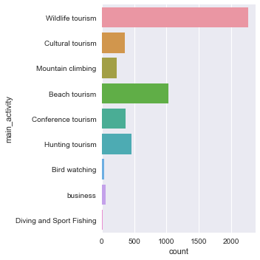
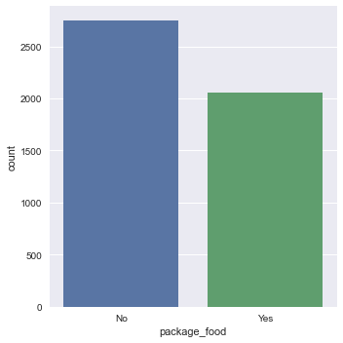
THE ASPECT OF TOURISM THAT IS THE MOST PROFITABLE AND THE MOST SORT-AFTER FOOD
FIGURE 5

Slide 9
OBERVATIONS FOR FIGURE 5
THE ASPECT OF TOURISM THAT IS THE MOST PROFITABLE
IS WILDLIFE TOURISM
THE MOST SORT-AFTER FOOD IS PACKAGE_FOOD

